Slide 1
Basic Digital Circuits & Minimization using Boolean ALgebra

Slide 2
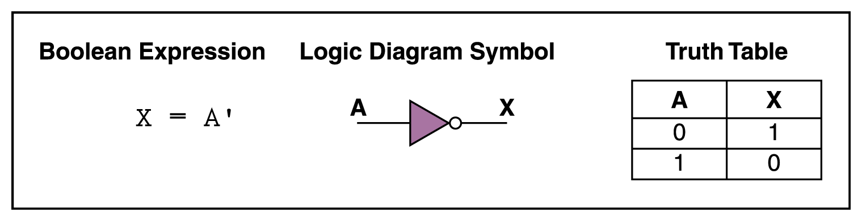
NOT Gate
A NOT gate accepts one input value and produces one output value

Slide 3
NOT Gate
By definition, if the input value for a NOT gate is 0, the output value is 1, and if the input value is 1, the output is 0
A NOT gate is sometimes referred to as an inverter because it inverts the input value

Slide 4
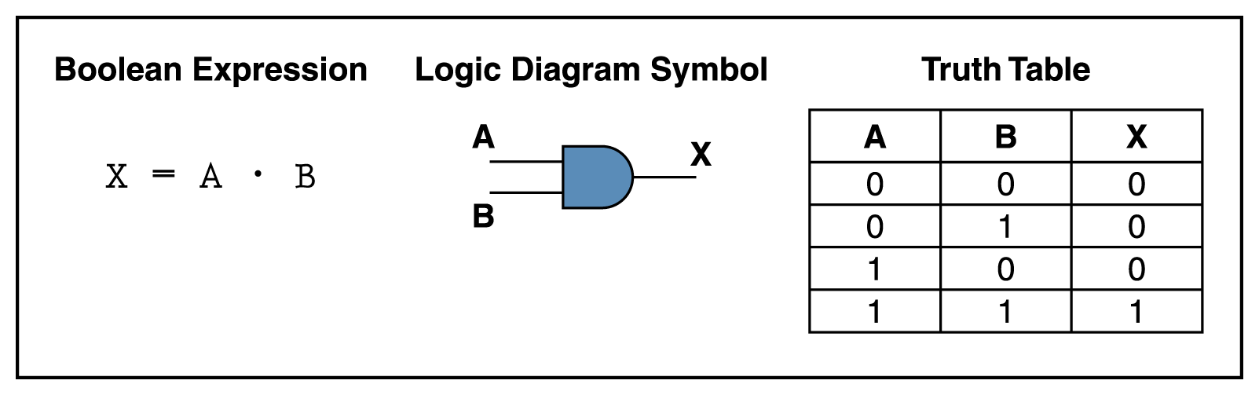
AND Gate
An AND gate accepts two input signals
If the two input values for an AND gate are both 1, the output is 1; otherwise, the output is 0

Slide 5
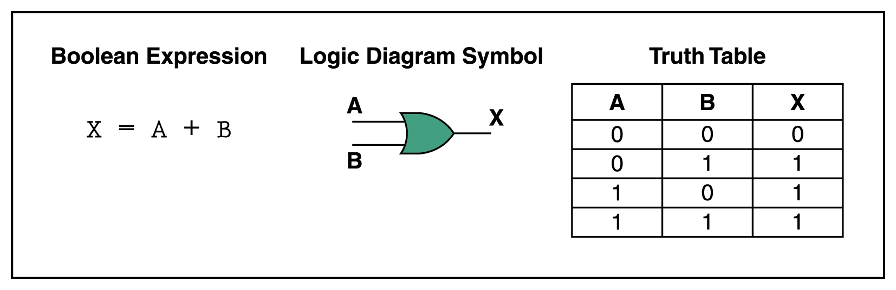
OR Gate
If the two input values are both 0, the output value is 0; otherwise, the output is 1

Slide 6
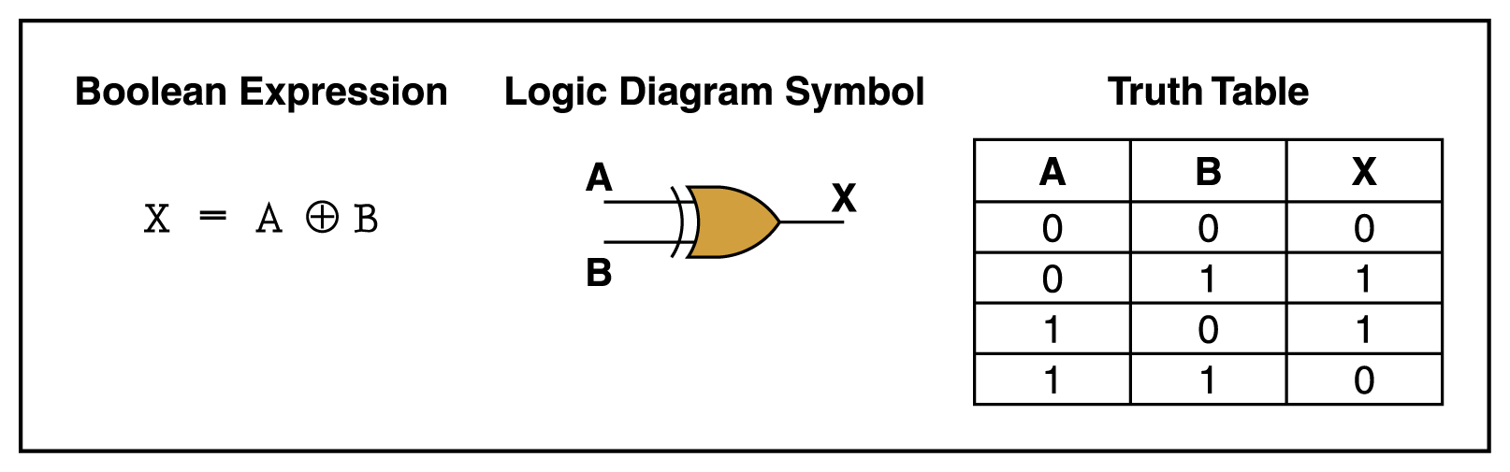
XOR Gate
X= A’ . B + A . B’
XOR, or exclusive OR, gate
An XOR gate produces 0 if its two inputs are the same, and a 1 otherwise

Slide 7
XNOR Gate
Also called Coincidence gate.
The Output is High when both the inputs are same or Coincident.
Y = A . B + A’ . B’
A
XNOR
Y
B
A | B | A’ | B’ | AB | A’B’ | Y=AB+A’B’
0 | 0 | 1 | 1 | 0 | 1 | 1
0 | 1 | 1 | 0 | 0 | 0 | 0
1 | 0 | 0 | 1 | 0 | 0 | 0
1 | 1 | 0 | 0 | 1 | 0 | 1

Slide 8
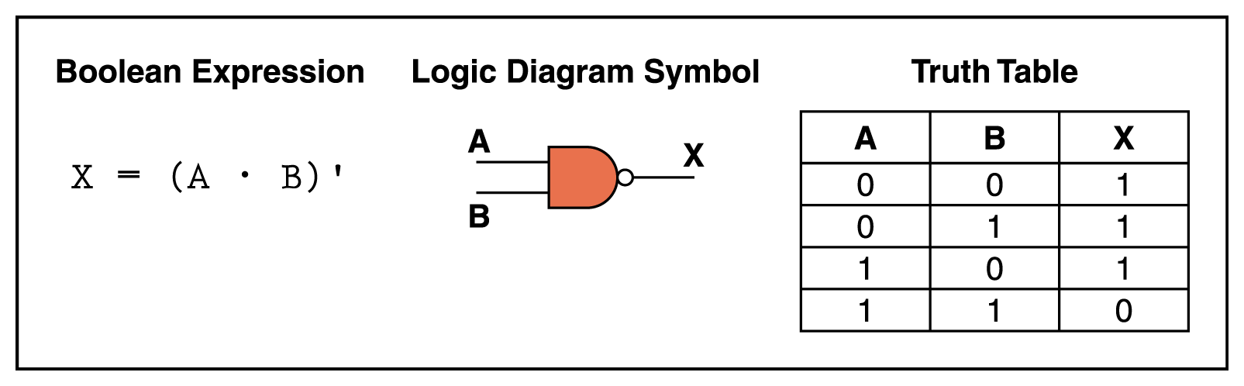
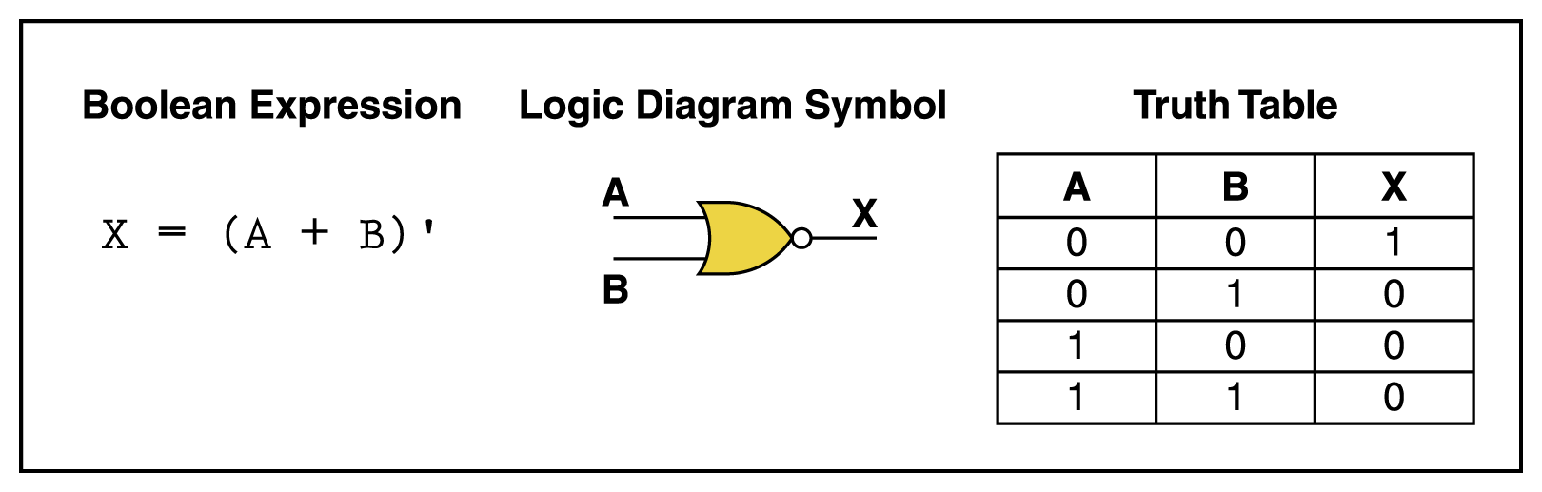
NAND and NOR Gates
The NAND and NOR gates are essentially the opposite of the AND and OR gates, respectively

Slide 9
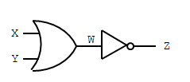
NOR Gate
X Y Z
0 0 1
0 1 0
1 0 0
1 1 0
X
Z
Y
Z = (X+Y)’

Slide 10

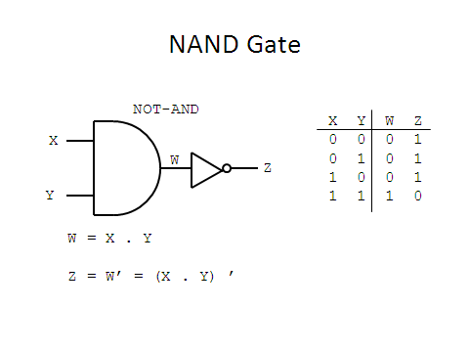
NAND Gate
X
Y
X | Y | Z
0 | 0 | 1
0 | 1 | 1
1 | 0 | 1
1 | 1 | 0
Notes:
Overview of basic NAND gate : Logic Symbol, Logic Expression (using DeMorgan’s) and Truth Table.

Slide 11
Universal Property - NAND & NOR

Slide 12

NAND Gate as an Inverter Gate
NAND GATE AS A UNIVERSAL LOGIC ELEMENT
(Before Bubble)
X
X | Z
0 | 1
1 | 0
Equivalent to Inverter
Notes:
When you tie the inputs on a NAND gate together, the output will be the complement of the input.

Slide 13

NAND Gate as an AND Gate
X
Y
NAND Gate
Inverter
X | Y | Z
0 | 0 | 0
0 | 1 | 0
1 | 0 | 0
1 | 1 | 1
Equivalent to AND Gate
Notes:
This one is easy to see, a NAND gate is an AND gate with the output inverted. So if you invert the output again, you will get an AND gate. Note that we are using a NAND gate for the inverter.

Slide 14
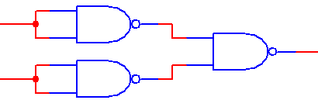
NAND Gate as an OR Gate
X
Y
Inverters
NAND Gate
X | Y | Z
0 | 0 | 0
0 | 1 | 1
1 | 0 | 1
1 | 1 | 1
Equivalent to OR Gate
Notes:
This one is a bit harder to see. If you invert both of the inputs of a NAND gate, you will get an OR gate. Note that we’re using NAND gates as inverters.

Slide 15
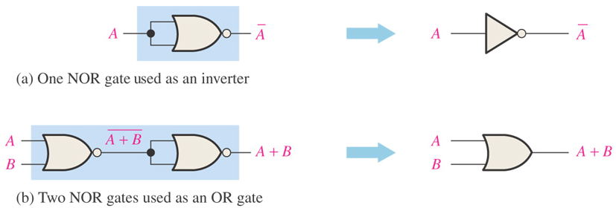
Universal Property - NAND & NOR
NOR GATE AS A UNIVERSAL LOGIC ELEMENT
NOR gate is also a universal gate because it can be used to produce the NOT, AND, OR and NAND functions.

Slide 16
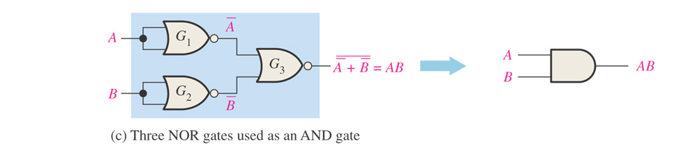
Universal Property - NAND & NOR
NOR GATE AS A UNIVERSAL LOGIC ELEMENT (Cont.)

Slide 17
Introduction to Boolean Algebra
Developed by English Mathematician George Boole in between 1815 - 1864.
It is described as an algebra of logic or an algebra of two values i.e True or False.
The term logic means a statement having binary decisions i.e True/Yes or False/No.

Slide 18
Application of Boolean algebra
It is used to perform the logical operations in digital computer.
In digital computer True represent by ‘1’ (high volt) and False represent by ‘0’ (low volt)
Logical operations are performed by logical operators. The fundamental logical operators are:
1. AND (conjunction)
2. OR (disjunction)
3. NOT (negation/complement)

Slide 19
Truth Table
Truth table is a table that contains all possible values of logical variables/statements in a Boolean expression.
No. of possible combination =
2^{n}, where n=number of variables used in a Boolean expression.

Slide 20
Truth Table
The truth table for XY + Z is as follows:
Dec X Y Z XY XY+Z
0 0 0 0 0 0
1 0 0 1 0 1
2 0 1 0 0 0
3 0 1 1 0 1
4 1 0 0 0 0
5 1 0 1 0 1
6 1 1 0 1 1
7 1 1 1 1 1

Slide 21
Boolean LAWS

Slide 22
(Existence of 1 and 0 element)
x + 0 = x
x · 0 = 0
x + 1 = 1
x · 1 = x
(Existence of complement)
(5) x + x = x
(6) x · x = x
(7) x + x’ = 1
(8) x · x’ = 0

Slide 23
(Commutativity):
(9) x + y = y + x
(10) xy = yx
(Associativity):
(11) x + ( y + z ) = ( x + y ) + z
(12) x (yz) = (xy) z

Slide 24
(Distributivity):
(13) x ( y + z ) = xy + xz
(14) x + yz = ( x + y )( x + z)
(DeMorgan’s Theorem)
(15) ( x + y )’ = x’ y’
(16) ( xy )’ = x’ + y’

Slide 25
(Absorption Law)
1)X+XY=X
LHS: X+XY
=> X(1+Y) Using 1+Y=1
=> X
2) X+X’Y=X+Y
LHS: X+X’Y
=>X+XY+X’Y Using X=X+XY i.e First Absorption Law
=>X+Y(X+X’) Using X+X’=1
=>X+Y

Slide 26
(Involution)
(17) (x’)’ = x

Slide 27
Minimization of Boolean Expression
Minimization of Boolean expression is needed to simplify the Boolean expression and thus reduce the circuitry complexity as it uses less number of gates to produce same output that can by taken by long expression.
Algebraic Method
- The different Boolean rules and theorems are used to simplify the Boolean expression in this method.

Slide 28
Minimization of Boolean Expression (Contd…)
Solved Problem
Minimize the following Boolean Expression:
a’bc + ab’c’ + ab’c + abc’ +abc
= a’bc + ab’(c’ + c) + ab(c’ + c) Using X + X’ = 1
= a’bc + ab’ + ab
= a’bc + a(b’ + b)
= a’bc + a
2. AB’CD’ + AB’CD + ABCD’ + ABCD
= AB’C(D’+D) + ABC(D’+D) Using X + X’ = 1
= AC(B’+B)
= AC

Slide 29
A | B | C | D | MINTERM | DESIGNATION | MAXTERM | DESIGNATION
0 | 0 | 0 | 0 | A’B’C’D’ | m₀ | A+B+C+D | M₀
0 | 0 | 0 | 1 | A’B’C’D | m₁ | A+B+C+D’ | M₁
0 | 0 | 1 | 0 | A’B’CD’ | m₂ | A+B+C’+D | M₂
0 | 0 | 1 | 1 | A’B’CD | m₃ | A+B+C’+D’ | M₃
0 | 1 | 0 | 0 | A’BC’D’
0 | 1 | 0 | 1 | A’BC’D
0 | 1 | 1 | 0
0 | 1 | 1 | 1
1 | 0 | 0 | 0
1 | 0 | 0 | 1
1 | 0 | 1 | 0
1 | 0 | 1 | 1
1 | 1 | 0 | 0
1 | 1 | 0 | 1
1 | 1 | 1 | 0
1 | 1 | 1 | 1

Slide 30
1.Prove A’+AB = (A’ +B) 2.(A+ B).(A’+C)= AC +A’B+BC 3.AB +A’C+BC =(A+C ).(A’+B)

